Slide 1
Aspect-Oriented Software Development
Aspect Mining
- 2008 -

Slide 2
Aspect Mining – Definition (1)
Aspect mining aims to identify crosscutting concerns in existing systems, thereby improving the system’s comprehensibility and enabling migration of existing (object-oriented) programs to aspect-oriented ones.
Aspect Discovery [Kellens et al. 2005]
  Early aspect discovery techniques (requeriments, domain analysis and architecture design)
  Dedicated browsers (navigate the code looking for crosscutting concerns)
  Aspect mining techniques (automate the process of aspect discovery and propose their user one or more aspect candidates)

Slide 3

Aspect Mining – Definition (2)
Aspect Mining is the activity of discovering, in the source code of a given software system, those cross-cutting concerns that potentially could be turned into aspects. We refer to such concerns as aspect candidates.
Aspect Refactoring is the activity of actually transforming the identified aspect candidates into real aspects in the source code.

Slide 4
Aspect Mining – Definition (3)
Requires human involvement.
Aspect mining tools yield seeds or aspect candidates.
After manual inspection by the user, candidates could be turned into:
  Confirmed seeds.
  Non-seeds or false positives.
False negatives are crosscutting concerns missed by the technique.
The key aspect mining challenge is to keep the percentage of confirmed seeds as high as possible.

Slide 5
Aspect Mining - Classification
Aspect mining techniques could be roughly classified into two categories:
  Static analysis: analyse program element frequencies and exploit the syntactic homogeneity of crosscutting concerns.
    Naming conventions, metrics, control-flow-graphs,…
  Dynamic analysis: analyse runtime behaviour of the program.
    Look for execution patterns during program execution.
      Each time method A() was executed so was method B().

Slide 6
Analyzing recurring patterns of execution traces
Dynamic analysis
Analyses program traces reflecting the run-time behaviour of a system in search of recurring execution patterns.
4 different execution relations:
  outside-before (B is called before A)
  outside-after (A is called after B)
  inside-first (G is the first call in C)
  inside-last (H is the last call in C)
Identifies aspect candidates based on recurring patterns of method invocations.
Relations should appear in different ‘calling context’.
  So they could be considered as seeds!
B() {
C() {
G()
H()
}
}
A() {}

Slide 7
Analyzing recurring patterns of execution traces
Hybrid approach: dynamic information is complemented with static type information in order to remove ambiguities and improve on the results of the technique.
S. Breu and J. Krinke. Aspect mining using event traces. In Conference on Automated Software Engineering (ASE), September 2004.

Slide 8
Formal concept analysis of execution traces
Dynamic analysis
Applies formal concept analysis (FCA) to execution traces in order to identify possible aspects.
What is FCA?
  FCA is a branch of lattice theory that can be used to identify meaningful groupings of elements that have common properties
Context
(elements,
properties on those elements)
FCA
Concepts
(maximal groups of elements and properties such that each element of the group shares the properties)

Slide 9
Formal concept analysis of execution traces
Execution traces are obtained by running an instrumented version of the program under analysis, for a set of scenarios (use-cases)
The relationship between execution traces and executed computational units (methods) is subjected to concept analysis
Context
Elements: the use-cases
Properties: the executed methods
FCA

Slide 10
Formal concept analysis of execution traces
A concept is a candidate aspect if:
  scattering: more than one class contributes to the functionality associated with the given concept (i.e., the methods labeling the concept belong to more than one class);
  tangling: the class itself addresses more than one concern (i.e., appears in more than one use-case specific concept).
The first condition alone is typically not sufficient to identify crosscutting concerns
Concepts
FCA

Slide 11
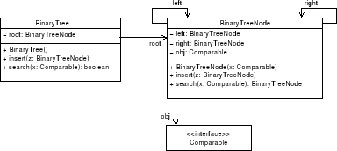
Formal concept analysis of execution traces – Ejemplo (1)
Ejemplo
Inserción
m1 BinaryTree.BinaryTree()
m2 BinaryTree.insert(BinaryTreeNode)
m3 BinaryTreeNode.insert(BinaryTreeNode)
m4 BinaryTreeNode.BinaryTreeNode(Comparable)
Búsqueda
m1 BinaryTree.BinaryTree()
m5 BinaryTree.search(Comparable)
m6 BinaryTreeNode.search(Comparable)
Trazas para cada
escenario ejecutado

Slide 12
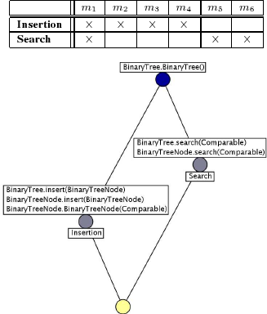
Formal concept analysis of execution traces – Ejemplo (1)
Scattering: the Insertion concept is labelled by methods from different classes (so is the Search concept).
Tangling: the same classes (BinaryTree and BinaryTreeNode) are included in different concepts (Search and Insertion).
Conclusion: insertion and search are crosscutting concerns.

Slide 13
Formal concept analysis of execution traces
Dynamo - Dynamic Aspect Mining Tool: http://star.itc.it/dynamo/
P. Tonella and M. Ceccato. Aspect mining through the formal concept analysis of execution traces. In 11th IEEE Working Conference on Reverse Engineering, 2004

Slide 14
Formal concept analysis of identifiers
Static analysis
Propose an alternative aspect mining technique which relies on formal concept analysis
Context
Elements: the classes and
methods in the system
Properties: substrings generated from the program entities used as elements
FCA
QuotedCodeConstant
‘Quoted’ ‘ Code’ ‘Constant’
Porter stemming algorithm (undo, undoable)
Substrings with little meaning are discarded (‘a’, ‘with’)

Slide 15
Formal concept analysis of identifiers
The FCA algorithm then groups entities with the same identifiers. When such a group contains methods from different classes it is considered a seed for a potential aspect.
The assumption behind this approach is that interesting concerns in source code are reflected by the use of naming conventions.
The most difficult task is that of deciding manually whether a concept identifies a valid aspect
Concepts
FCA
Notes:
Problema principal: -generación de muchos falsos positivos -> se generan muchos conceptos por el sólo hecho de que ciertas subcadenas son compartidas por algunos elementos.
-presencia de falsos positivos -> algunos artefactos del código fuente que sí estan relacionados son divididos en conceptos diferentes por el sólo hecho de no compartir la misma subcadena en su nombre.

Slide 16
Formal concept analysis of identifiers
DelfSTof source-code mining tool can readily access the code of the classes and methods belonging to a discovered concept
T. Tourwé and K. Mens. Mining aspectual views using formal concept analysis. In Source Code Analysis and Manipulation Workshop (SCAM), 2004.

Slide 17
Natural language processing on source code
Static analysis
Try to identify crosscutting concerns in existing source code by exploiting the natural language clues that the developers left behind
Use of lexical chaining to identify groups of semantically related source code entities, and evaluate whether those groups represent crosscutting concerns
Collection of words
Chains of words
which are strongly related
Lexical chaining
Notes:
PLN: subdisciplina de la inteligancia artificial. Estudia el problema de la generación automática y el entendimiento de los lenguajes naturales.

Slide 18
In class com.sun.j2ee.blueprints.supplier.orderfulfillment.ejb.OrderFufillmentFacadeEJB
/**
* Tries to fullfill an order with items in inventory
*/
private String processAnOrder(SupplierOrderLocal po)
throws XMLDocumentException {
boolean allItemsAvailable = true;
boolean invoiceReqd = false;
String invoiceXml = null;
HashMap items = new HashMap();
Collection liColl = po.getLineItems();
Iterator liIt = liColl.iterator();
while((liIt != null) && (liIt.hasNext())) {
LineItemLocal li = (LineItemLocal) liIt.next();
if(li.getQuantity() == li.getQuantityShipped())
continue;
if(!checkInventory(li)) {
allItemsAvailable = false;
continue;
}
li.setQuantityShipped(li.getQuantity());
items.put(li.getItemId(), OrderStatusNames.COMPLETED);
invoiceReqd = true;
}//end while
if(allItemsAvailable)
po.setPoStatus(OrderStatusNames.COMPLETED);
if(invoiceReqd) {
try {
invoiceXml = (createInvoice(po, items));
} catch (XMLDocumentException xe) {
//so order wont be fullfilled but po is persisted
//and can be fullfilled later.
System.out.println("OrderFulfillmentFacade**" + xe);
return null;
}
}
return invoiceXml;
}
Finished
In com.sun.j2ee.blueprints.opc.ejb.InvoiceMDB
/**
* update POEJB to reflect items shipped, and also update Process Manager
* to completed or partially completed status based on the items shipped
* in the order's invoice. If the join condition is met and all items are
* shipped, then send an order completed message to user
*
* @return orderMessage if order completed
* else null if NOT completed
*/
private String doWork(String xmlInvoice) throws XMLDocumentException, FinderException {
String completedOrder = null;
PurchaseOrderHelper poHelper = new PurchaseOrderHelper();
invoiceXDE.setDocument(xmlInvoice);
PurchaseOrderLocal po = poHome.findByPrimaryKey(invoiceXDE.getOrderId());
boolean orderDone = poHelper.processInvoice(po, invoiceXDE.getLineItemIds());
//update process manager if this order is completely done, or partially done
//for this purchase order
if(orderDone) {
processManager.updateStatus(invoiceXDE.getOrderId(), OrderStatusNames.COMPLETED);
completedOrder = invoiceXDE.getOrderId();
} else {
processManager.updateStatus(invoiceXDE.getOrderId(), OrderStatusNames.SHIPPED_PART);
}
return completedOrder;
}

Slide 19
Natural language processing on source code
Semantic Distance (the strength of relationship)
  Use Wordnet(a database of known relationships between words) to identify relationships, then find distance
writing
literary work
novel
poem
thesis
novel and poem are closer than thesis and poem

Slide 20
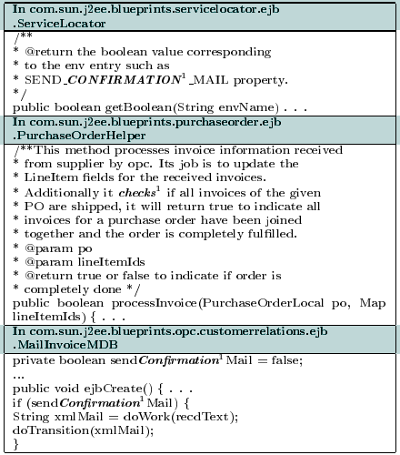
Natural language processing on source code
To find crosscutting concerns we look for chains that have members with a high amount of scatter (i.e., the word members are from many different source files).
Example: PetStore. Generate 700 chains and took 7 hours to complete.
Customer notification concern.

Slide 21
Natural language processing on source code
The assumption behind this technique is also that crosscutting concerns are reflected in source code through naming conventions.
In order to identify the aspect candidates, the user of their approach needs to manually inspect the resulting chains.
D. Shepherd, T. Tourwé, and L. Pollock. Using language clues to discover crosscutting concerns. In Workshop on the Modeling and Analysis of Concerns, 2005.

Slide 22
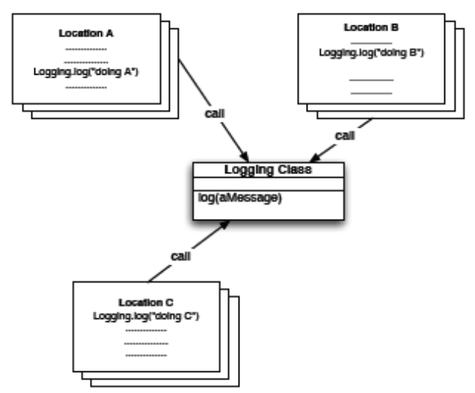
Detecting unique methods
Static analysis
In pre-AOP days, cross-cutting concerns were often implemented in an idiomatic way, an example of such an idiom is the implementation of a cross-cutting concern by means of a single entity in the system which is called from numerous places in the code
Unique methods
“a method without a return value which implements a message implemented by no other method”

Slide 23
Detecting unique methods - Algorithm
Calculate all the Unique Methods in a system
Filter out irrelevant methods (like for instance accessor methods)
Sort according to the number of times a method is called
Manually inspect the resulting methods in order to find suitable aspect candidates

Slide 24
Detecting unique methods
Regardless of the simplicity of this approach, the authors demonstrated the applicability of their technique by detecting typical aspects like tracing, update notification and memory management in the context of a Smalltalk image.
K. Gybels and A. Kellens. Experiences with identifying aspects in smalltalk using ’unique methods’. In Workshop on Linking Aspect Technology and Evolution, 2005.

Slide 25
Hierarchical clustering of related methods
Static analysis
Use agglomerative hierarchical clustering to group related methods
Starts by putting each method in a separate cluster
Compare all pairs of groups using a distance function, mark the pair that is the smallest distance apart
If the marked pair's distance is smaller than a threshold value, merge the two groups. Otherwise stop the algorithm.
Returns all of the groups whose membership is larger than 1

Slide 26
Hierarchical clustering of related methods
Salida:
NLP based distance function.
Clusters are stored as trees.
Shepherd y Pollock (2005) “Interfaces, aspects and views”.
- doActivity
+ UndoActivity
UndoRedoActivity
Substring común
UndoRedoActivity (UndoRedoActivity)
createUndoRedoActivity (UndoRedoActivity)
Hojas
método
Clase

Slide 27
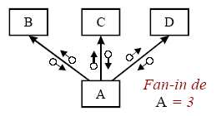
Fan-in Analysis
Static analysis
Fan-in metric: counts the number of locations from which control is passed into a module. In the context of object orientation the module type to which this metric is applied is the method.
Method fan-in depends on the way we take polymorphic methods into account.

Slide 28
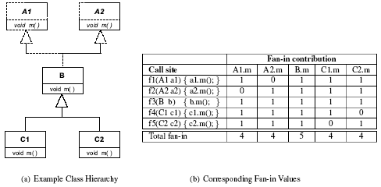
Fan-in Analysis
Example class hierarchy and corresponding fan-in values

Slide 29
Fan-in analysis - Algorithm
Automatic computation of the fan-in metric for all methods in the investigated system.
Filtering of the results from the previous step by
  eliminating all methods with fan-in values below a chosen threshold
  eliminating the accessor methods (methods whose signature matches a get*/set* pattern and whose implementation only returns or sets a reference )
  eliminating utility methods, like toString() and collection manipulation methods
Manually analyzing the remaining methods

Slide 30
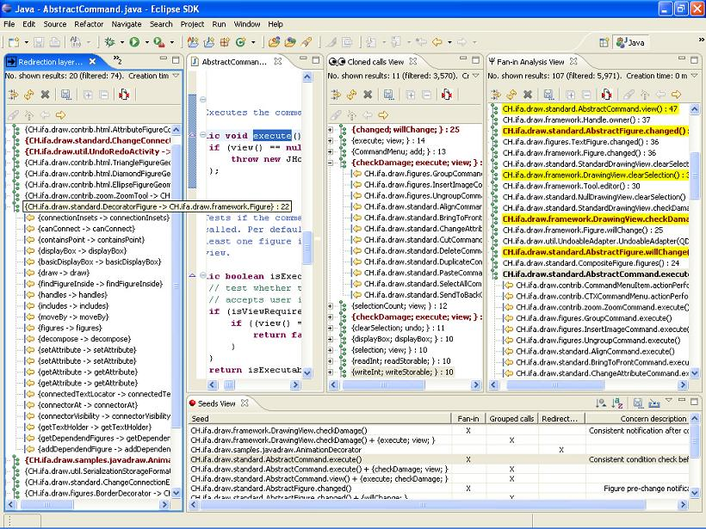
FINT - Tool support for aspect mining
Fan-in analysis view
FINT is implemented as an Eclipse plug-in
Redirection
finder view
Grouped calls
analysis view
Seeds view
Notes:
Redirections finder, which investigates classes whose methods consistently execute redirection of their callers to dedicated methods of another class.

Slide 31
Fan-in analysis
M. Marin, A. Deursen, and L. Moonen. Identifying aspects using fan-in analysis. In Proc. of the 11th IEEE Working Conference on Reverse Engineering (WCRE 2004), Delft, The Netherlands, November 2004. IEEE Computer Society.
Tools:
  FINT: http://swerl.tudelft.nl/bin/view/AMR/FINT
  SoQueT: http://swerl.tudelft.nl/bin/view/AMR/SoQueT
  http://sepc.twi.tudelft.nl/~marin/work.html

Slide 32
Detecting clones as indicators of crosscutting concerns
Static analysis
Symptoms (indicators of cross-cutting concerns in the source code)
  Code duplication
Two techniques use this observation
  Program dependence graphs (PDG) to detect possible aspects
    Their current tool targets “before” advice that executes before a method in a specified set of methods is run.
  Token-based, AST-based and metrics-based clone detection

Slide 33
Detecting clones as indicators of crosscutting concerns - PDG
Construct source-level PDGs for all methods
Identify refactoring candidates
Filter undesirable refactoring candidates
Coalesce related sets of candidates into classes
  coalesces the pairs into sets of similar candidates

Slide 34
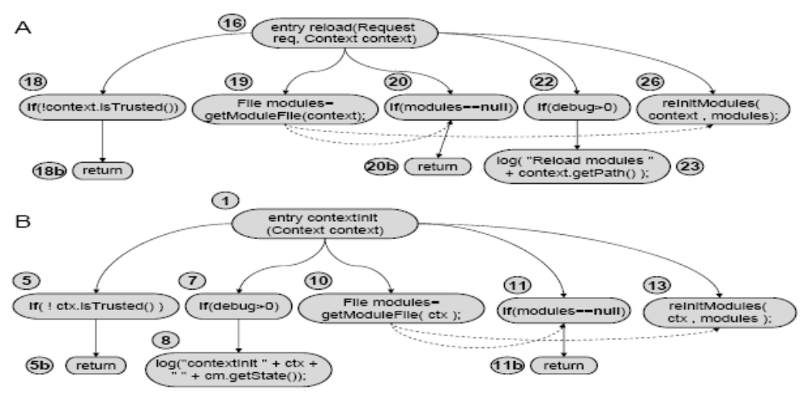
Detecting clones as indicators of crosscutting concerns - PDG
Construction of source-level PDGs for all methods
    Each statement in the code is represented by a node
    The edges of the graph consist of control or data dependence relations between the statements

Slide 35
Detecting clones as indicators of crosscutting concerns (2nd approach)
Text-based techniques
  No transformation to the source code before attempting to detect identical or similar (sequences of) lines of code
Token-based techniques
  Apply a lexical analysis (tokenization) to the source code, and subsequently use the tokens as a basis for clone detection

Slide 36
Detecting clones as indicators of crosscutting concerns (2nd approach)
AST-based techniques
  Use parsers to first obtain a syntactical representation of the source code, typically an abstract syntax tree (AST). The clone detection algorithms then search for similar subtrees in this AST
Metrics-based techniques
  For each fragment of a program the values of a number of metrics is calculated, which are subsequently used to find similar fragments.

Slide 37
Detecting clones as indicators of crosscutting concerns
D. Shepherd, E. Gibson, and L. Pollock. Design and evaluation of an automated aspect mining tool. In International Conference on Software Engineering Research and Practice, 2004.
M. Bruntink, A. v. Deursen, R. v. Engelen, and T. Tourwé. An evaluation of clone detection techniques for identifying crosscutting concerns. In Proceedings of the IEEE International Conference on Software Maintenance (ICSM). IEEE Computer Society Press, 2004.

Slide 38
Criteria of Comparison
Static versus dynamic
  Does the technique take as input data which can be obtained by statically analyzing the source code, or dynamic information which is obtained by executing the program, or both?
Incremental
  Some techniques try to discover all possible aspects in a system at once while other techniques support a more incremental process where aspects can be identified one at a time.

Slide 39
Criteria of Comparison
Lexical and structural/behavioral
  Lexical Lightweight reasoning about the program at a lexical level: sequences of characters, regular expressions
  Structural/Behavioral analysis of the program: parse tree, type information, message sends, …

Slide 40
Criteria of Comparison
Tangling and scattering
  Scattering means that the code corresponding to an aspect or crosscutting concern is dispersed across the entire system, instead of being located in a single module
  Tangling means that concern code is often intermixed with that of other concerns.
  The techniques differ in whether they explicitly take scattering and/or tangling into account, or only implicitly.

Slide 41
Criteria of Comparison
Scalability
  What is the size of systems that the technique can be applied on? For some techniques there may be an upper limit in order to still produce results in a reasonable amount of time, whereas other techniques may only work on systems that have at least some minimum size.
Symptoms
  What are the “symptoms of aspects” that the different techniques try to exploit in order to mine for aspects?
    Code duplication
    Naming conventions

Slide 42
Criteria of Comparison
 | static | dynamic | Token-based | structural
Execution patterns | - | X | - | X
Dynamic analysis | - | X | - | X
Identifier analysis | X | - | X | -
Language clues | X | - | X | -
Unique methods | X | - | - | X
Clustering | X | - | X | -
Fan-in analysis | X | - | - | X
Clone detection | - | X | X | X

Slide 43
Criteria of Comparison
 | scattering | tangling | symptoms
Execution patterns | X | - | Recurring invocations
Dynamic analysis | - | X | Scat/Tang
Identifier analysis | X | - | Nam. Conv.
Language clues | X | - | Nam. Conv.
Unique methods | X | - | Idioms
Clustering | X | - | Nam. Conv.
Fan-in analysis | X | - | High Scat.
Clone detection | X | - | Code Dupl.

Slide 44
Aspect Mining Tools
Scattering based approaches
FCA – Formal Concept Analysis
Tool | Analysis Type | Aspect Mining Result
Dynamit | Dynamic Analysis of execution traces | List of candidate aspects
Tool | Analysis Type | Aspect Mining Result
Delfstof Dynamo | FCA – analysis FCA – analysis of execution traces | List of candidate aspects exploratory inspected List of candidate aspects manually inspected

Slide 45
Bibliography
[Kellens et al. 2005] Kellens, A., Mens, K.: A survey of aspect mining tools and techniques. Technical report, INGI 2005-07, Universite catholique de Louvain, Belgium (2005)
Grigoreta Sofia Cojocar, Gabriela Serban. On Some Criteria for Comparing Aspect Mining Techniques. Department of Computer Science. Babes-Bolyai University
M. P. Robillard and G. C. Murphy. Concern graphs: Finding and describing concerns. In Proc. Int. Conf. on Software Engineering (ICSE). IEEE, 2002.

